Slide 1
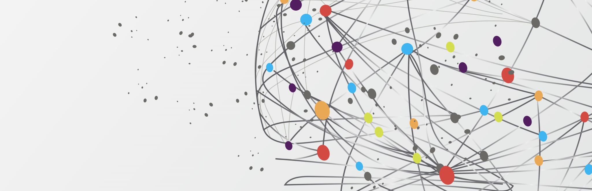

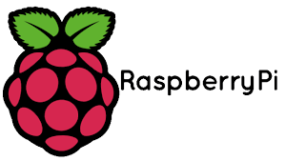
TensorFlow for Edge Computing

Slide 2
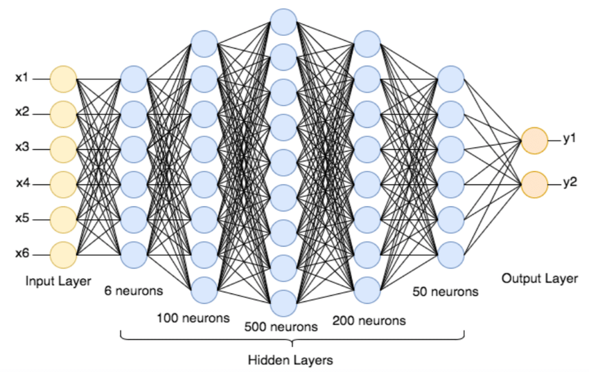
Deep neural networks

Slide 3
Deep neural networks requires sufficient amount of memory and storage.
It is usually preferred to train deep learning models on GPUs. (Not always)
It does require lot of data but there are techniques like meta-learning using which models have been trained with less number of data.

Slide 4
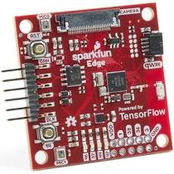
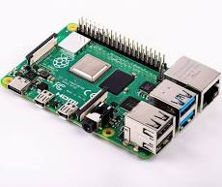

What are edge-devices?
An edge device is any piece of hardware that controls data flow at the boundary between two networks.
Common examples include IoT devices, smart home equipment and also mobile phones.

Slide 5
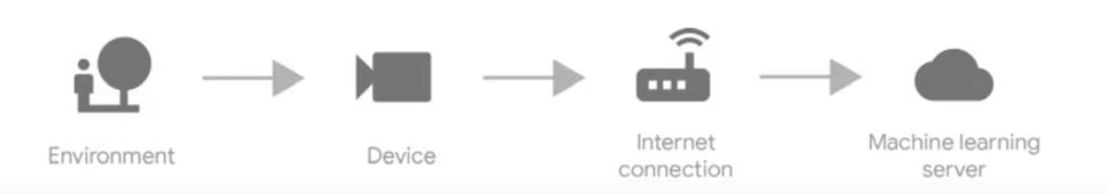
Flow of data through an ML system
Data is collected by the edge-device and sent to the server.
Inference happens on the server.
If required, the result is sent back to the device.

Slide 6
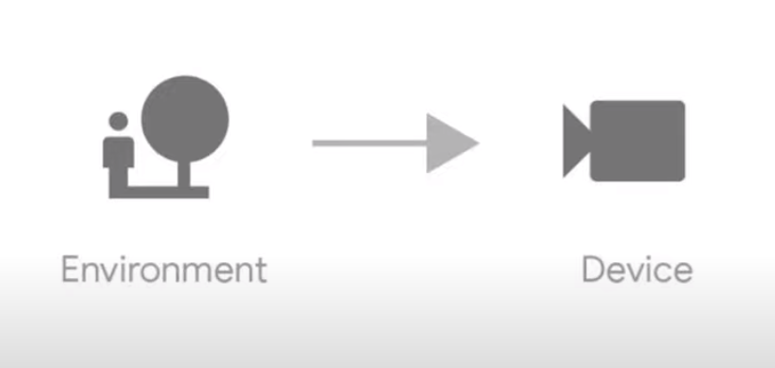
On-device inference
Advantages:
Lesser bandwidth
Latency
Increased privacy and security.

Slide 7
Challenges
Edge-devices have limited amount of resources such as,
Memory
Power &
Storage

Slide 8
TensorFlow Lite
A toolkit for running deep learning inference on edge-devices.
Deep learning models that we train are converted to a form that works well on embedded or mobile devices using TFLite.
These models are optimised to run under resource constraints.
The TFLite interpreter will run the model and run inference for us on edge-device.
Before we can deploy our trained model, it needs to go through a conversion process.

Slide 9
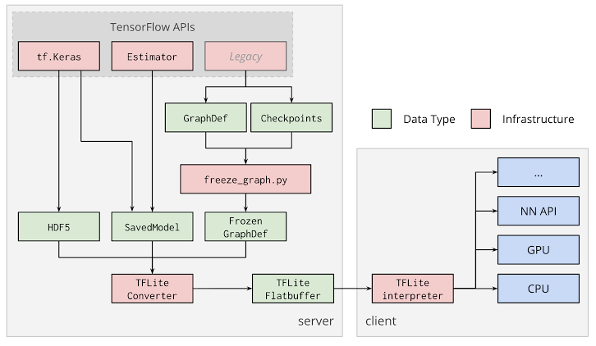
Deployment

Slide 10
Steps
Train the model. Save it in the required format.
Convert the saved model into a TFLite Flatbuffer using TFLite converter.
TFLite Flatbuffer will be saved in the directory with an extension ‘.tflite’
This file is used for deployment on edge-devices using TFLite interpreter.

Slide 11
Why models should be optimized?
Size reduction
Smaller storage size.
Smaller download size.
Uses less RAM when executed.
Latency
Optimizations can reduce the time required to run inference.
Accelerator compatibility

Slide 12
Optimizations in TFLite
Quantization
Works by reducing the precision of the numbers used to represent a model’s parameters.
Pruning
Works by removing insignificant parameters which have very less impact on the model’s performance.
Clustering
Works by grouping the weights of each layer in a model into predefined number of clusters, then sharing the centroid values for the weights belonging to each individual cluster for a specific layer.

Slide 13
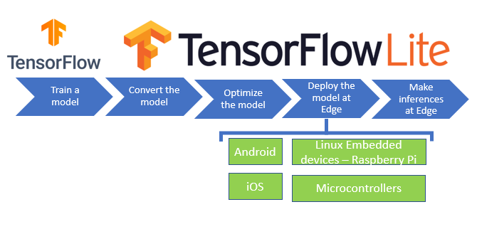
Testing the converted model
Once the model.tflite file is ready, we can test it locally using the TFLite Interpreter before actually deploying on any embedded or mobile device.

Slide 14
Installing TFLite on Raspberry Pi
Just install the TFLite Interpreter (Only for inference)
(https://www.tensorflow.org/lite/guide/python)
Build the full TensorFlow from source. More complicated and takes more time.
(https://www.tensorflow.org/lite/guide/build_rpi)

Slide 15
Gesture based home automation on Raspberry Pi
Train the model using TensorFlow Keras.
Convert the model to TFLite model.
Use the TFLite model to perform inference on Raspberry Pi.

Slide 16
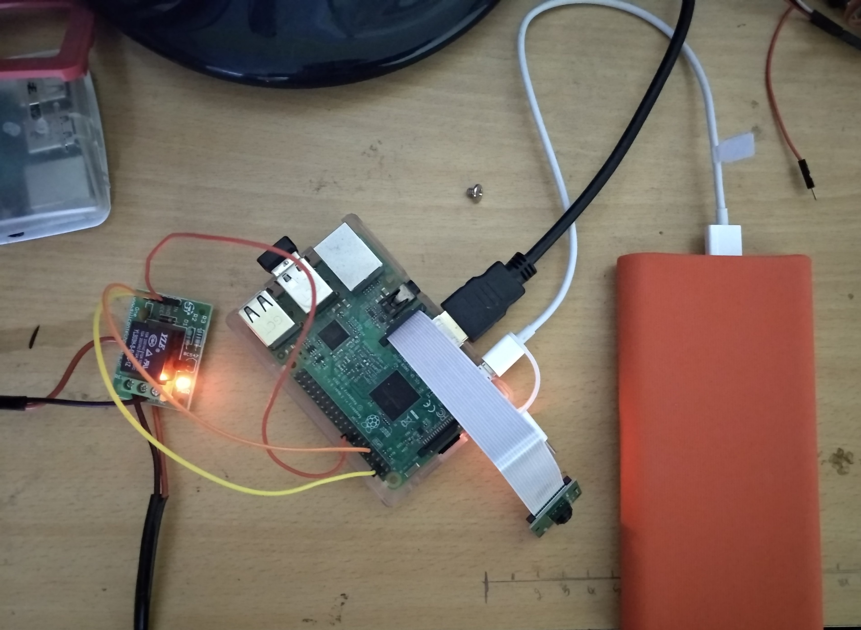
Setup

Slide 17
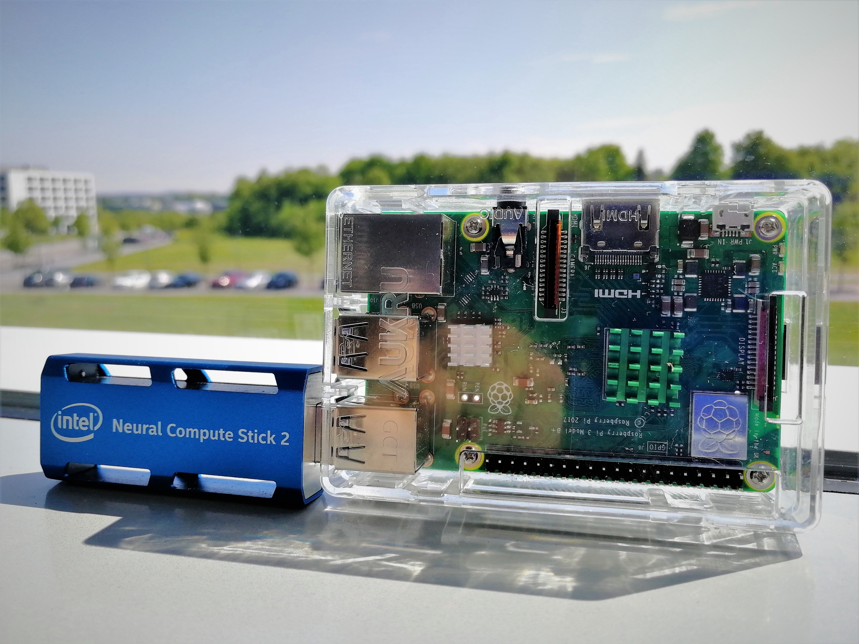
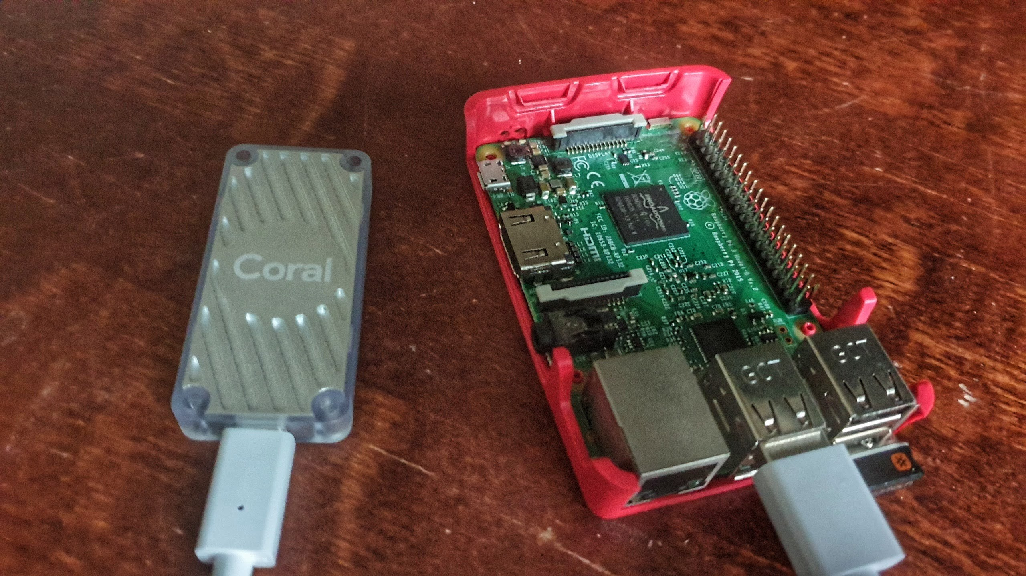
Accelerators

Slide 18
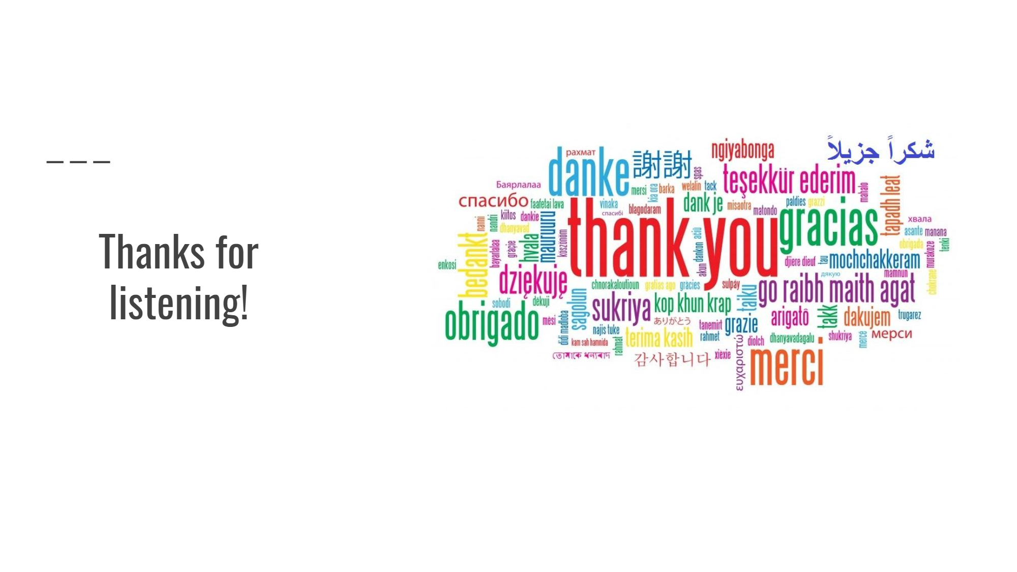

Slide 19
QUESTIONS?

